Slide 1

Topic: Graphing EQ: What are step graphs and how to create it in excel?
Year 11 Essentials

Slide 2
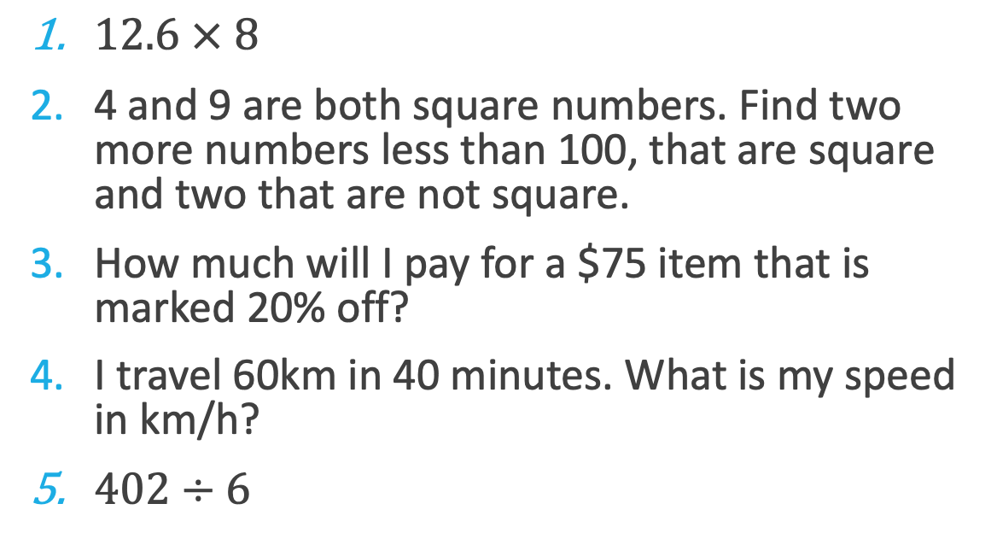
First 5
Topic: Graphing EQ: What are step graphs and how to create it in excel?
$12.6 × 8$
4 and 9 are both square numbers. Find two more numbers less than 100, that are square and two that are not square.
How much will I pay for a $75 item that is marked 20% off?
I travel 60km in 40 minutes. What is my speed in km/h?
$402÷6$
100.8
Square numbers: 25, 36, 49, 64, 81
$60
90km/h
67

Slide 3
Topic: Graphing EQ: What are step graphs and how to create it in excel?
A step graph is used when independent variable is continuous (e.g., time, or distance), but the dependent variable is discrete – it jumps in stages (e.g., costs that are charged in increments)
What is a step graph?
Where is it useful?
Step graphs are very commonly used for calculating costs.
For Example:
Taxi rates: the amount charged is calculated per whole kilometer.
Package costs: fixed costs are charged for weight ranges of parcels and are not adjusted for sized in between
Professional charge out rates: A plumber will often charge a call-out fee then an additional fee per hour.

Slide 4
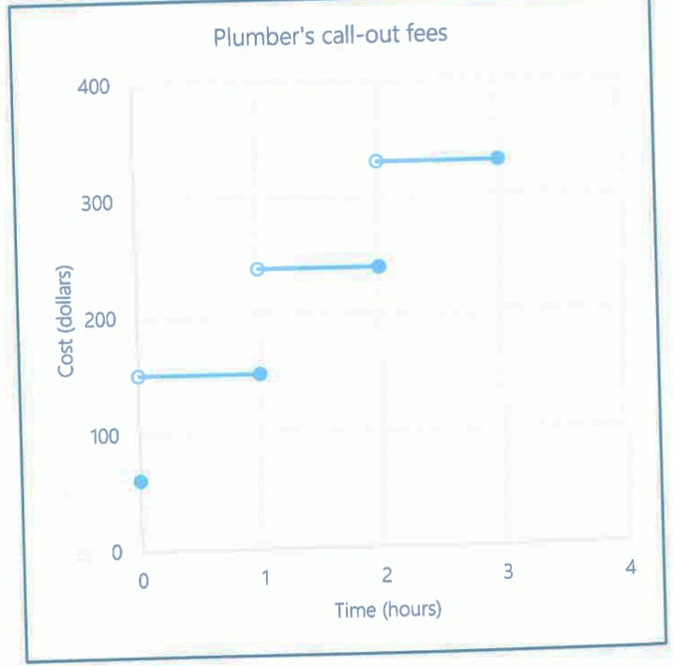
Topic: Graphing EQ: What are step graphs and how to create it in excel?
Text, P. 90. (Aggregate of online questions from Australian Plumbers, 2020).
If the plumber comes to your house and decides that she cant do the work, you still pay a $60 call out fee. How much do you pay if she does half an hour of work?
How much do you pay if the plumber works for 2 hours and 45 minutes?
Why do you think some of the circles are not open (not filled in) and some are closed (filled in)?

Slide 5
Topic: Graphing EQ:
TASK: Graphing
Follow the instructions on page 91 to create a step graph on excel.
Then complete application question 4, after completing excel.
Notes:
Computers will be needed to be able to practice creating step graphs on excel.

